Slide 1
Travel Planner App with AI Itinerary
Fundamentals of Data Engineering-24DEA3101
BACH-19
2420030094 – A Sindhuja
2420090033 – K Komali Hasini
2420090040 – K Rishitha Reddy

Slide 2
Methodology
User Input: Collect destination, travel duration, budget, and interests.
Data Processing: Clean and analyze travel data collected from datasets/APIs.
AI Recommendation: Analyze user preferences and recommend suitable attractions and activities.
Itinerary Generation: Create a personalized day-wise travel schedule based on time, budget, and preferences.
Customization: Allow users to modify and save the generated itinerary.
Final Output: Display the complete personalized travel plan through the application.

Slide 3
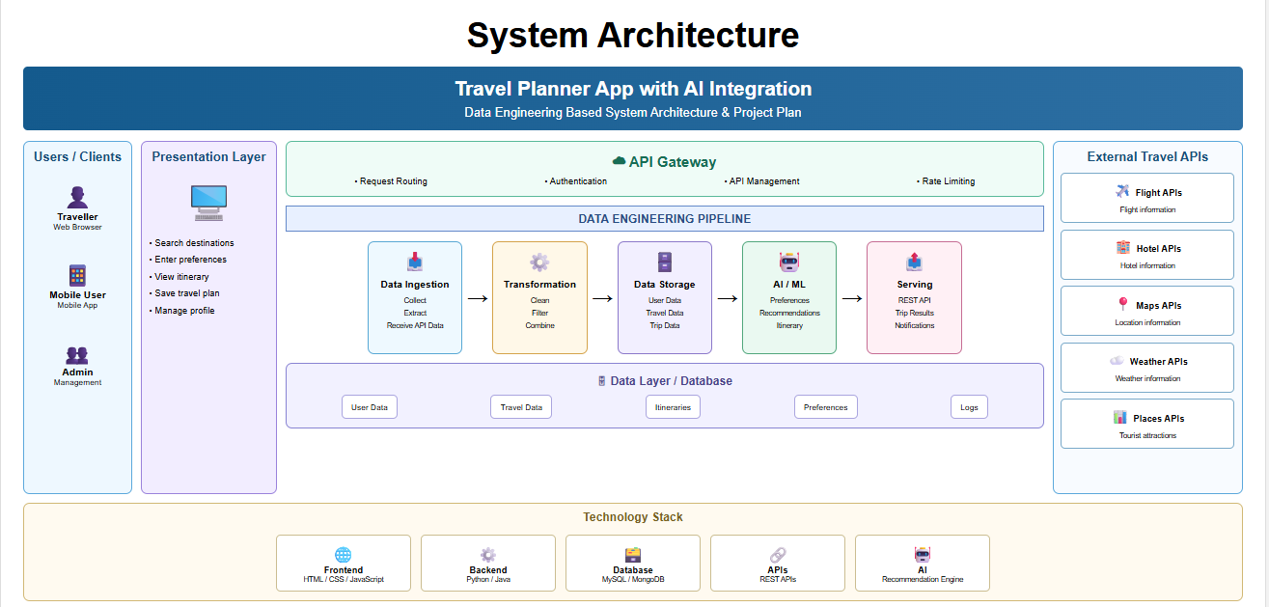

Slide 4
Modern Tools and Technologies
Python – Data collection, processing, and automation
REST APIs – Collect real-time travel, weather, and location data
ETL Pipeline – Extract, Transform, and Load travel data
SQLite / PostgreSQL – Store structured travel data
Apache Airflow – Schedule and automate data pipelines
Apache Spark – Process large-scale travel datasets
Generative AI / LLM – Generate personalized travel itineraries

Slide 5
Implementation
Data Collection: Collect destination, budget, duration, interests, and traveler details through the application.
Data Ingestion: Fetch travel-related data from APIs/datasets.
Data Processing: Use Python, Pandas and NumPy to clean, transform, and organize the data.
Data Pipeline: Build an ETL pipeline to Extract, Transform, and Load travel data into the database.
Data Storage: Store processed travel information using SQLite/PostgreSQL or cloud storage.
AI Processing: Analyze user preferences and generate suitable travel recommendations.
Itinerary Generation: Create a personalized day-wise itinerary based on destination, budget, time, and interests.
Application Interface: Use Streamlit to display recommendations and the generated itinerary.

